Slide 1
BUILD PROFIT WITH SAUSAGE INGREDIENTS

Slide 2
Johnsonville sausage ingredient overview
Satisfying with protein has never been easier
Increase profit with cost-effective proteins
Ethnic sausage is a menu staple at restaurants
So what?:
The Brand Consumers Choose
Easy Portion Control, Optimizes Food Cost & Profit Margin
Easy to Prep, Reduces Labor Cost
A Profitable Choice
Notes:
Competitive advantage – consumer-preferred brand; Johnsonville is #1 sausage brand
Attract consumers – Brand Johnsonville on the menu for instant consumer recognition and brand trust
Retain and attract employees – using fully cooked, easy to prep proteins
Reliable source – our QA & food safety exceeds USDA guidelines
Increase profit / Expand margin with our sausage ingredients:
-upcharge for bigger protein portions
-more cost effective protein / double protein topper

Slide 3
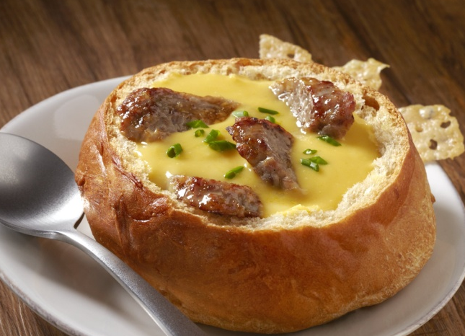
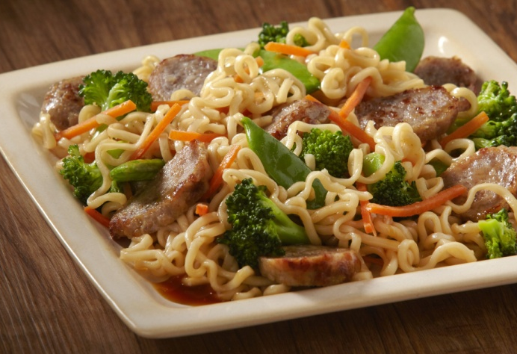
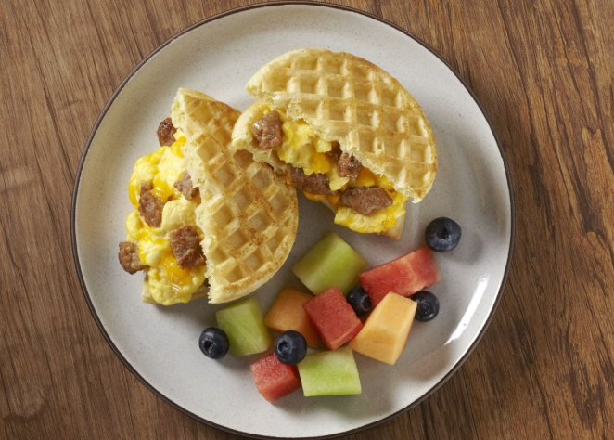
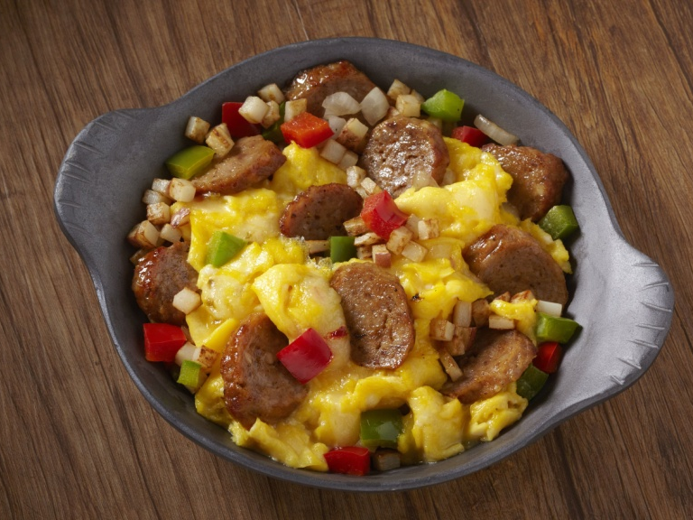
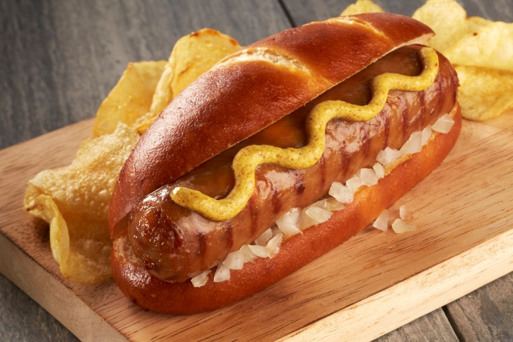
sausage does more for your menu
Increase Profits. Increase Sales. Attract and Retain Customers. Gain Competitive Advantage.
Sausage is growing
Better profitability
Across all dayparts
More flavor
Double protein
#1 sausage brand
Notes:
10 Customer Business Needs:
Increase in profits
Retain and attract
Competitive advantage

Slide 4
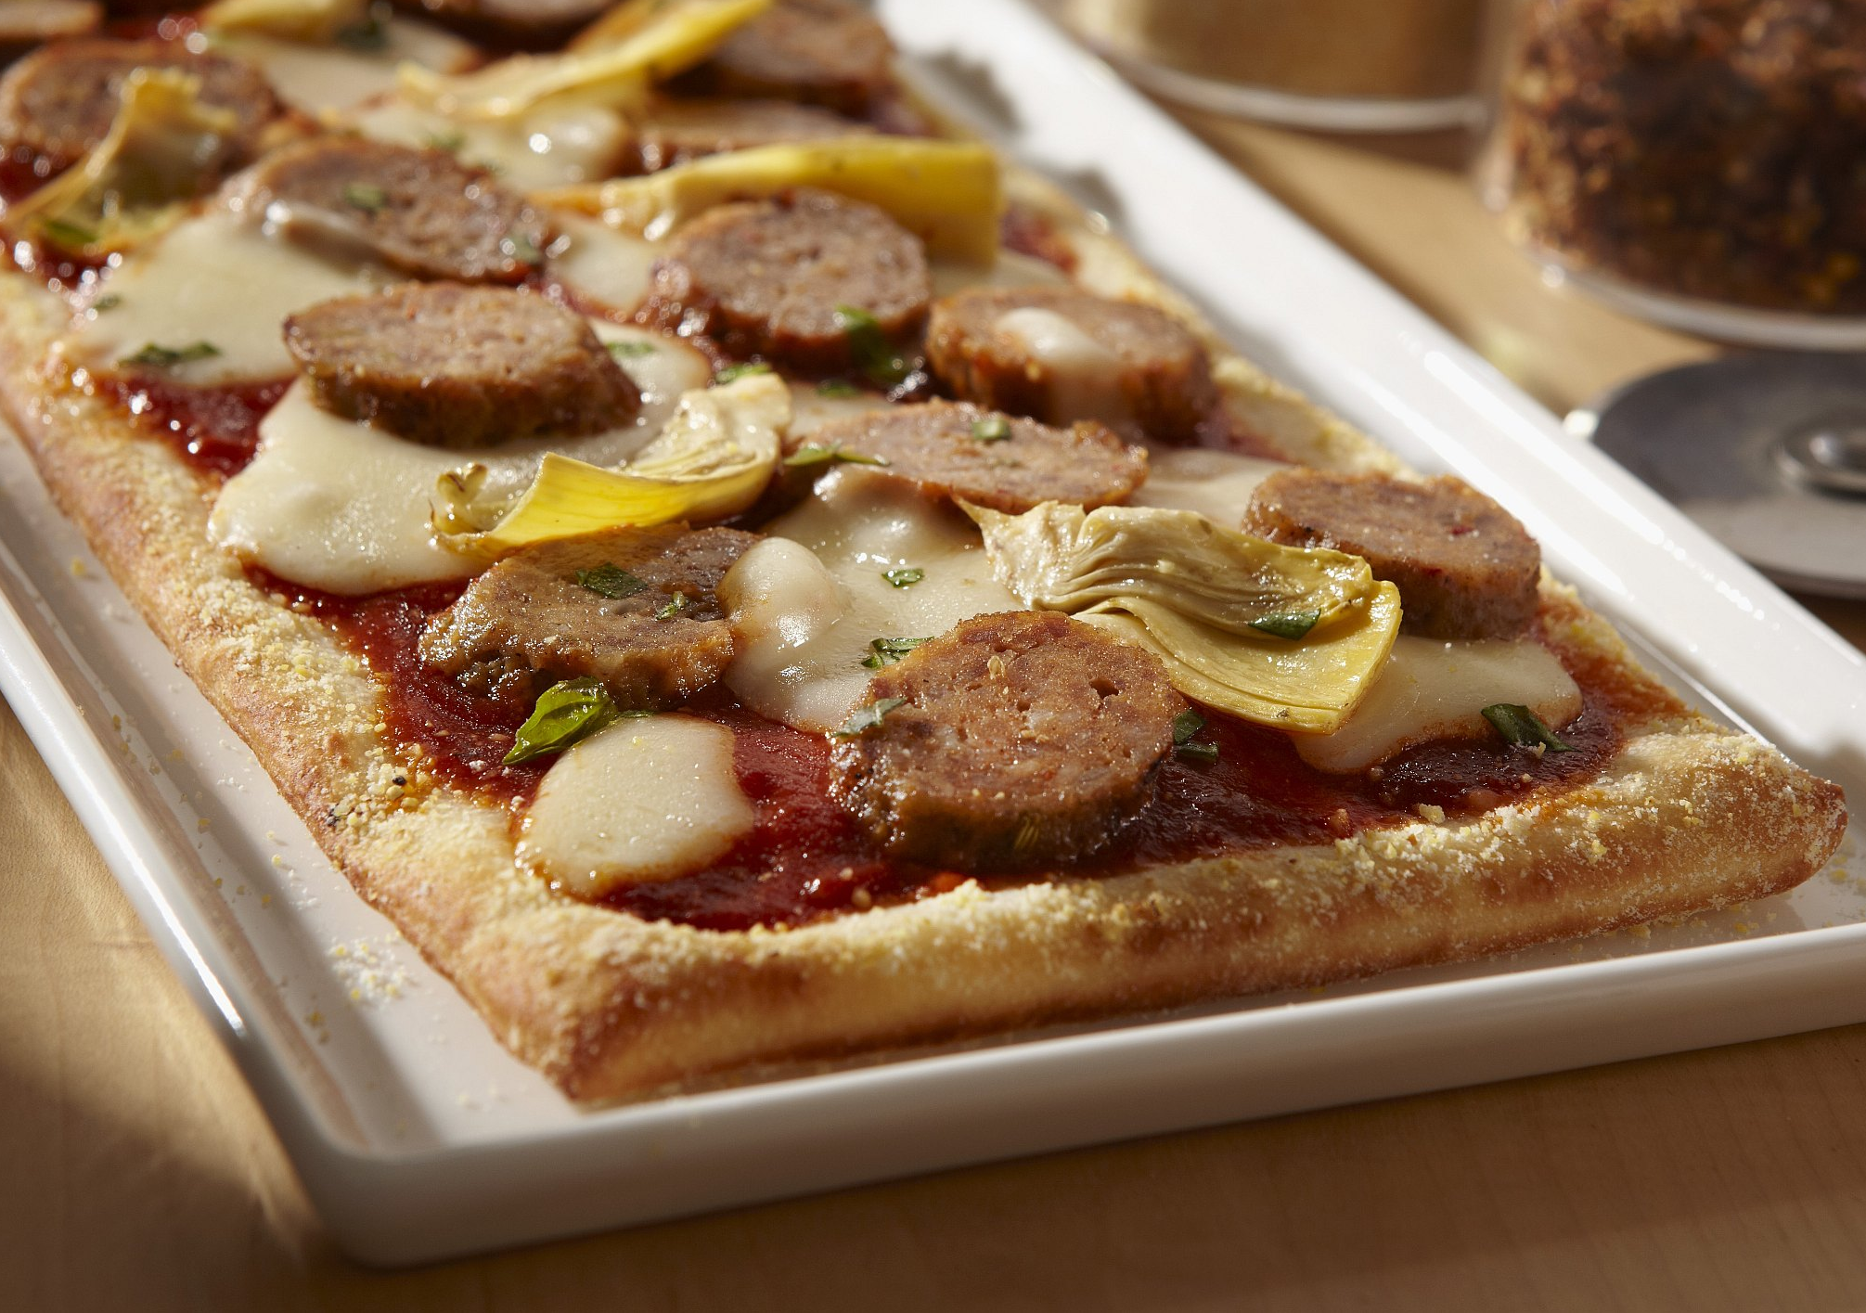
sausage is growing on menus
Increase Profits. Attract and Retain Customers with in-demand proteins.
Sausage ingredients on US menus have grown +7% in the past 10 years.
Dishes with sausage have grown across all major restaurant segments.
Source: Mintel Menu Insights January 2018
Notes:
10 Customer Business Needs:
Reliable Source
Increase in profits
Retain and attract

Slide 5
Differentiate Your Menu
Ultimate Slices
Split Sausage Links
Sausage Crumbles
¼” Bias-Sliced Sausage
Fully cooked, highly consistent IQF products
Chef-prepared appearance
Coarse, crumbly texture of a fresh sausage
A no-hassle way to add flavor to any dish
Pre-Split Butterflied Sausage Links
A new and different way to create a sandwich
Provides more surface area to develop the flavorful caramelization consumers crave
Multiple flavor options that fit a variety of buns, rolls and biscuits in your pantry
Original Crumbles
Juicy sausage distinctively seasoned with sage and black pepper
Fully-cooked for easy preparation, with a hand-pinched appearance
Delicious any time, for any meal, bringing great value across dayparts
Notes:
10 Customer Business Needs:
Increase in profits
Retain and attract

Slide 6
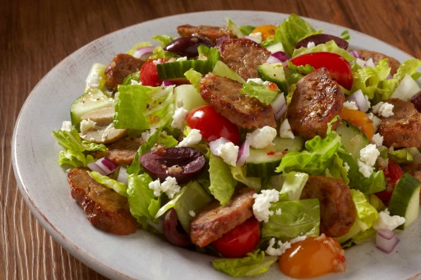
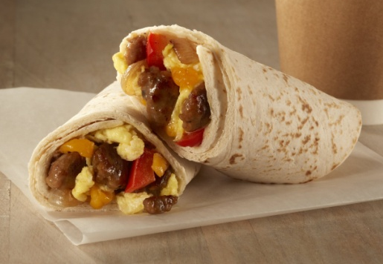
Johnsonville ingredients operational benefits
Consistently Pre-Sliced
Bias-Cut Slices, looks chef-prepared
Splits evenly cut down center
Convenient, Saves Labor & Prep
Fully cooked. Simply heat and add to any dish
Preserve Profits
Easily control portion sizes
Calculate profit vs other proteins
Variety of Flavors & Formats
Meets many menu needs
Fits on variety of breads in pantry
Versatile
Across all dayparts: breakfast, lunch, dinner, share plates and snacking

Slide 7
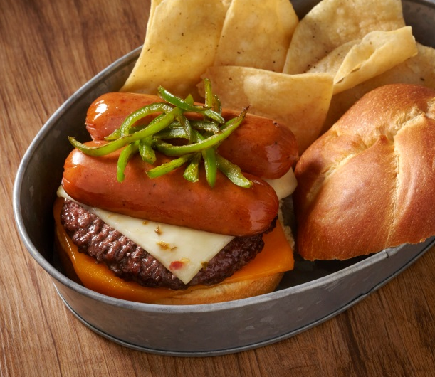
Sausage is Better Value than Bacon
Add Value with Double Protein. “Wow” & Attract customers.
More Meat │ More Flavor │ Enhanced Juiciness
Consider the food cost implications
Consider the amount of protein delivered
Consider the patron experience
EXAMPLE
– Go to your Working Calculator
 | Bacon (18/22 ct slices) | Johnsonville Split Sausage | Johnsonville Sausage Slices
Cost/unit | $0.20/slice | $0.4629/link* | $0.0348/slice
Portion size Protein wt. | 3 slices per burger .72 oz. | 1 per burger 2.28 oz. (217% ) | 6-8 slices per burger 1.2-1.6 oz. (67-122% )
Item food cost | $0.60 | $0.46 | $0.21-0.28
*Jalapeno Cheddar Split cost used in this example. See Notes for pricing.
Notes:
Sausage is a More Effective protein topper.
*Team will need to enter prices based on customer/distributor pricing.
*Comparison should be using premium, thick-cut bacon vs commodity bacon. Consider different variables (fully cooked vs raw premium bacon, labor cost to cook raw bacon, yield/loss with bacon fat rendering vs. meatier Johnsonville sausage weight, sausage is juicier than dry bacon.)
Splits ~35 links/package (70 links/case). More than double the meat vs 3 slices of bacon.
Slices ~425 slices/package (850 slices/case). About double the meat vs 3 slices of bacon.
Pricing:
Jalapeno Cheddar Splits are $3.24 per pound, or $32.40 per case
Smoked Splits are $2.99 per pound, or $29.90 per case
Chicken Splits are $3.34 per pound, or $33.40 per case
Slices are $2.96 per pound, or $29.60 per case (10 lbs)

Slide 8
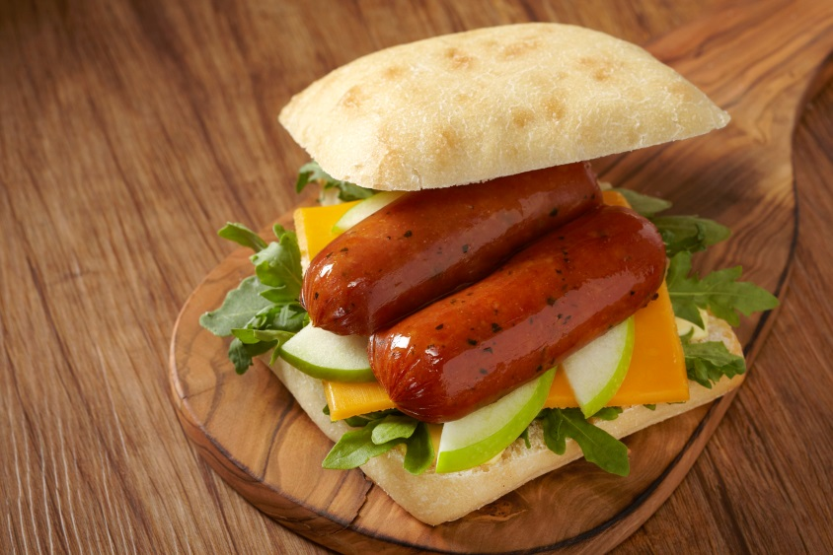
Split sausage makes sandwiches unique
Go beyond the traditional sandwich and create a new culinary experience
Create a Profit Center using Existing Pantry Items
Easy to use with Multiple Bread Carriers: Pretzel Bun, Kaiser Roll, Hamburger Bun, Bagel, Croissant, Pancake, Waffle, French Toast, Snack Wrap
Perfect for share plates, sampler platters, & slider baskets.
Notes:
Perfect for share plates, sampler platters, slider baskets.

Slide 9
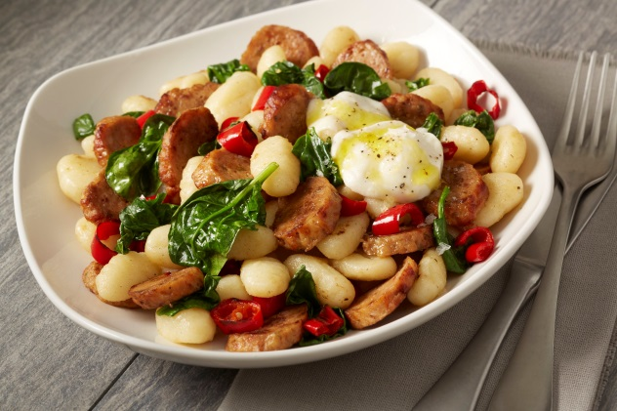
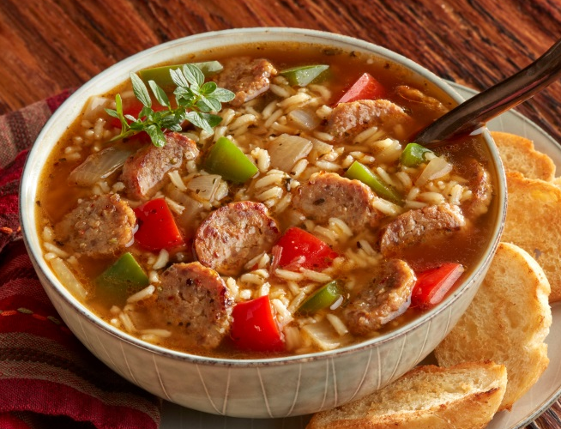
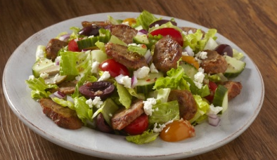
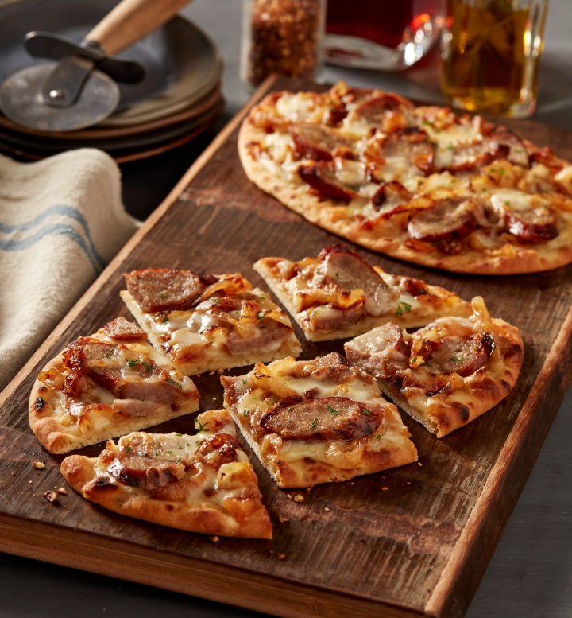
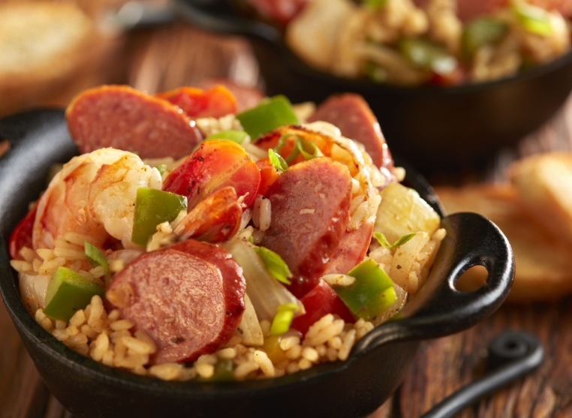
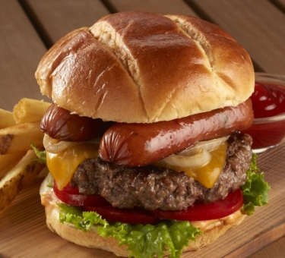
Performs across the menu
Cost-effective way to Add Flavor. Easy Prep for all dishes.
Notes:
-Easy Prep for all dishes
-Cost-effective way to Add Flavor

Slide 10
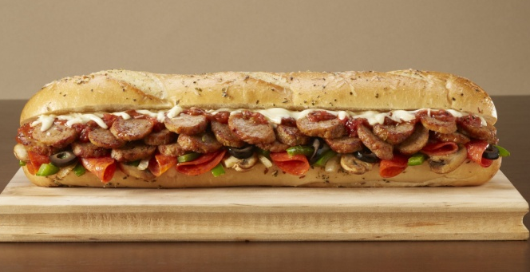
Johnsonville Brand Strength
Gain competitive advantage. Attract consumers. Reliable source.
Italian Sausage
Brats
Specialty Sausages
#1 Italian Sausage brand in the U.S. with the highest loyalty levels*
100% pure pork, made with proprietary blend of authentic spices
Popular with diners all year long
#1 Brat brand in the U.S. with the highest loyalty levels*
Unforgettable naturally grilled taste in every bite
Featured in over 50 stadiums nationwide
#1 Smoked/Cooked Link brand in the U.S. with the highest loyalty levels*
Only freshest spices and cuts of pork and beef
Naturally smoked with hardwood chips for a bold flavor
* IRI 1/4/19
Notes:
Competitive advantage – consumer-preferred brand; Johnsonville is #1 sausage brand
Attract consumers – Brand Johnsonville on the menu for instant consumer recognition and brand trust
Retain and attract employees – using fully cooked, easy to prep proteins
Reliable source – our QA & food safety exceeds USDA guidelines

Slide 11
Johnsonville Split Sausage Links
Old World Smoked Split Sausage
Smokehouse Jalapeno Bacon Cheddar Split
Sdf
Sdf
JVL Item# 103526
JVL Item# 101845
Product Size 7:1
Product Size 7:1
Distrib. # XXXXX
Distrib. # XXXXX

Slide 12
Johnsonville Ultimate Sausage Slices
¼” Bias-sliced Andouille
¼” Bias-sliced Italian
¼” Bias-sliced
Italian (bulk)
¼” Bias-sliced
Brat
JVL Item # 100964
JVL Item # 102891
2/5 lb. bags
Gluten-free and no MSG
Gluten-free and no MSG
30 lb. case
2/5 lb. bags
JVL Item # 100790
JVL Item # 100960
Gluten-free and no MSG
Gluten-free and no MSG
2/5 lb. bags
Distrib. # XXXXX
Distrib. # XXXXX
Distrib. # XXXXX
Distrib. # XXXXX

Slide 13
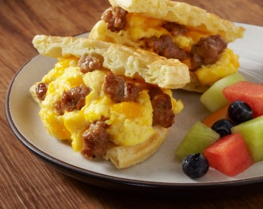
Johnsonville Sausage crumbles
Original Breakfast Crumbles
Original Italian Crumbles
Product Size Varies
Distrib.# XXXXX
JVL SKU# 101533
Product Size Varies
Distrib.# XXXXX
JVL SKU# 103547
Notes:
The classic taste of breakfast sausage to complement any dish, anytime of day.

Slide 14
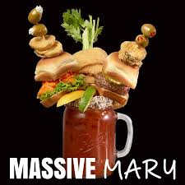
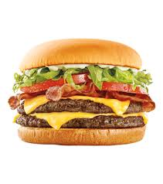
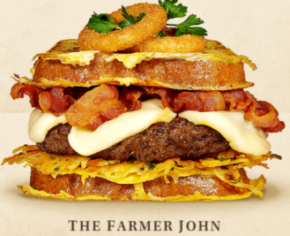
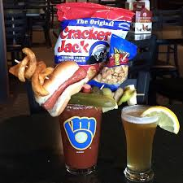
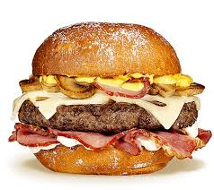
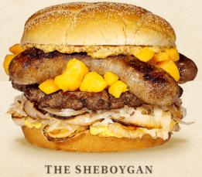
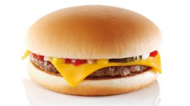
What’s in it For You?
Increase profit by expanding margin with lower priced proteins
Increase profit by upcharging for larger protein portion sizes
Retain customers by delivering an exceptional dining experience with heartier portions
Sausage Slices can be a more cost effective protein topper
Food cost for Split Sausage and Sausage Slices is less than bacon
Upcharge for delivering more protein with sausage than bacon
Big proteins are why some people keep coming back
$1.00
$6.79
$8.99
$9.89
$11.89
>$25.00
Notes:
*Use either slide 14 or 15
10 Customer Business Needs:
Increase in profits
Retain and attract

Slide 15
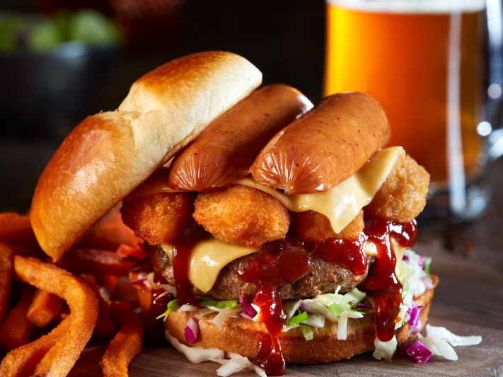
What’s in it For You?
Increase profit by expanding margin with lower priced proteins
Increase profit by upcharging for larger protein portion sizes
Retain customers by delivering an exceptional dining experience with heartier portions
Sausage Slices can be a more cost effective protein topper
Food cost for Split Sausage and Sausage Slices is less than bacon
Upcharge for delivering more protein with sausage than bacon
Big proteins are why some people keep coming back
Notes:
OPTION 2
Add Johnsonville Slices and Splits to Increase Profit and Retain and attract Customers and keep them coming back.
10 Customer Business Needs:
Increase in profits
Retain and attract

Slide 16
What’s in it For You?
Increase Profits
By expanding margin with lower priced proteins, upcharging for bigger protein
portions and using sausage slices and splits as a more cost effective protein topper
Increase Sales
By providing new menu items across all dayparts
Attract AND Retain Customers
By offering innovative products, packed with big protein
Attract AND Retain Quality Employees
By utilizing an easy to prepare, versatile product line
Gain Competitive Advantage
By offering more flavor, more protein and menu items that customers crave
Provide a Reliable Source of Products/Services
By serving the #1 sausage brand in America
Notes:
*Use either slide 14 or 15
10 Customer Business Needs:
Increase in profits
Retain and attract

Slide 17
Appendix: Sausage trend support

Slide 18
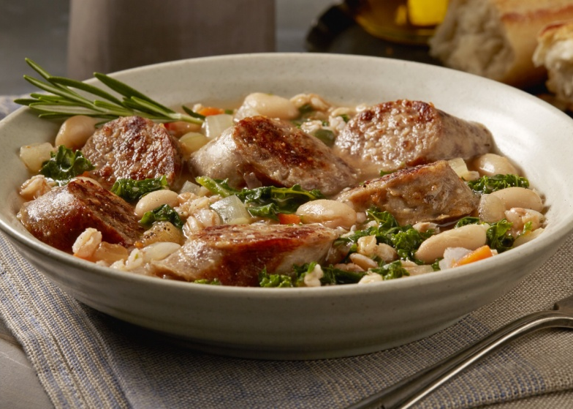
ETHNIC SAUSAGE ON THE RISE AT RESTAURANTS
Andouille:
+12%
Brat:
+22%
Jalapeno:
+73%
4-year growth
Source: Datassential MenuTrends, October 2014 to October 2018
Notes:
10 Customer Business Needs:
Increase in profits
Retain and attract
Competitive advantage

Slide 19
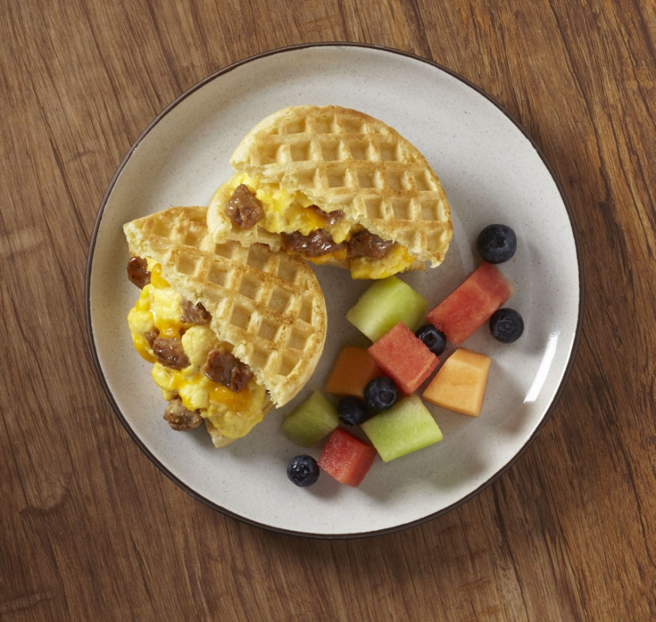
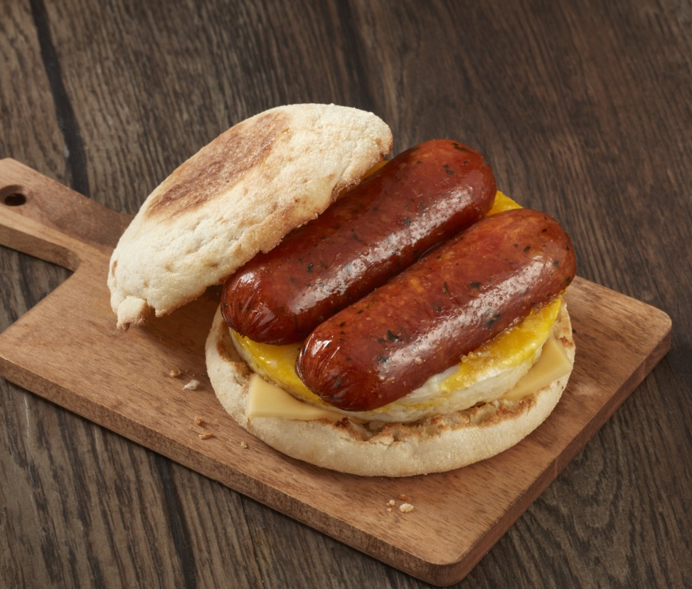
breakfast
Retain customers with in-demand protein ingredients.
Breakfast in foodservice has grown +39% from 2008-2018.
Breakfast sausage has grown +130% from 2008-2018.
Source: Datassential MenuTrends 2019
Notes:
Sausage is on 73% of US breakfast menus
Chorizo has grown +12% from 2014-2018
10 Customer Business Needs:
Increase in profits
Retain and attract
Reliable source

Slide 20
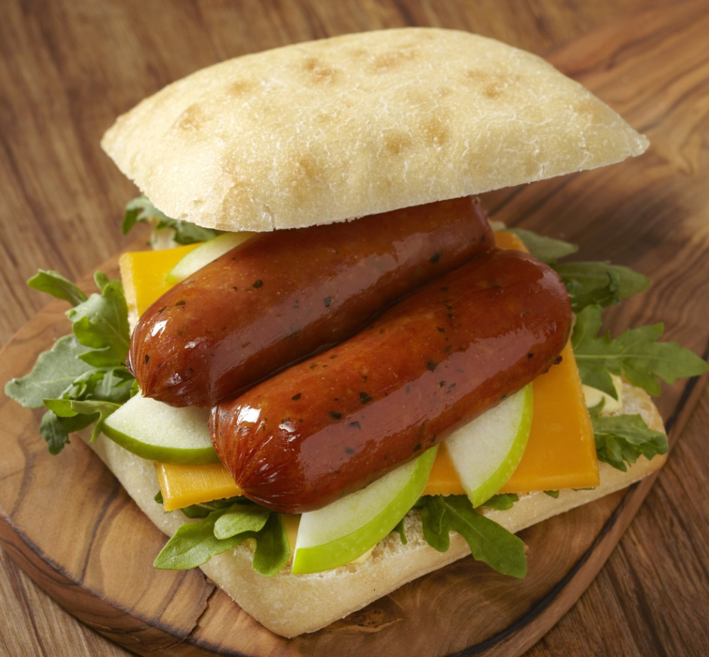
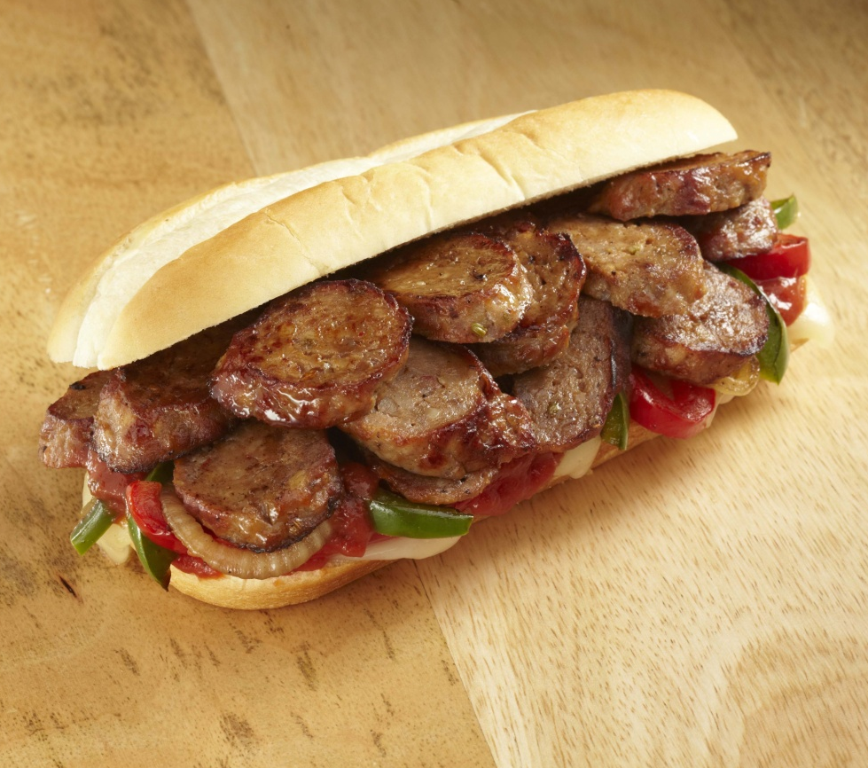
sandwiches
Retain customers with in-demand protein ingredients.
Pork items make up 4 out of the 5 top sandwich proteins.
Sausage is one of the only sandwich proteins that is growing.
Source: Datassential MenuTrends 2018
Notes:
Brioche, Pretzel & Biscuit are the top growing sandwich carriers
Cuban sandwich has grown +24% over the last 4 years
10 Customer Business Needs:
Increase in profits
Retain and attract
Competitive advantage
Reliable source

Slide 21
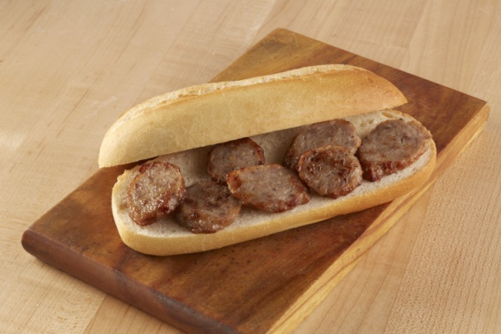
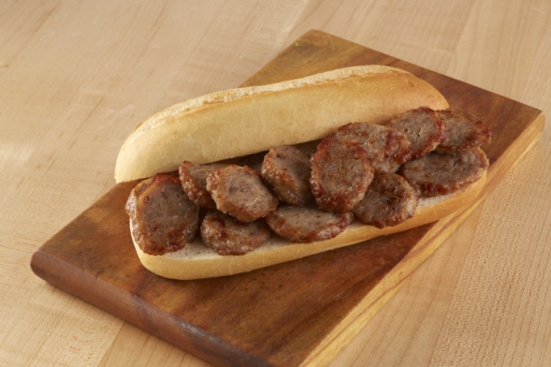
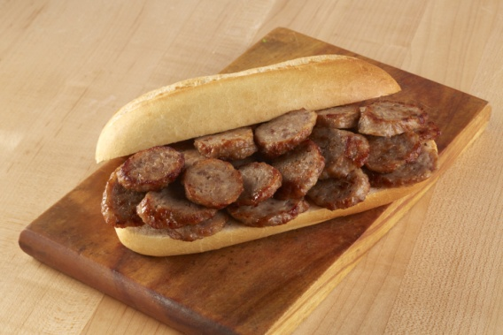
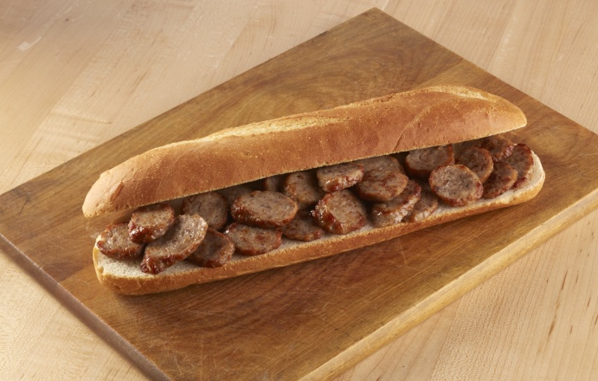
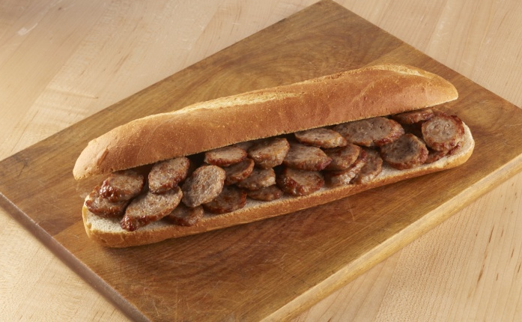
Bias-sliced Portion Control – 6 AND 12 INCH SUBS
1 oz. on 6” roll
2 oz. on 6” roll
3 oz. on 6” roll
Control your profit margin with Johnsonville Slices
3 oz. on 12” roll
4 oz. on 12” roll

Slide 22
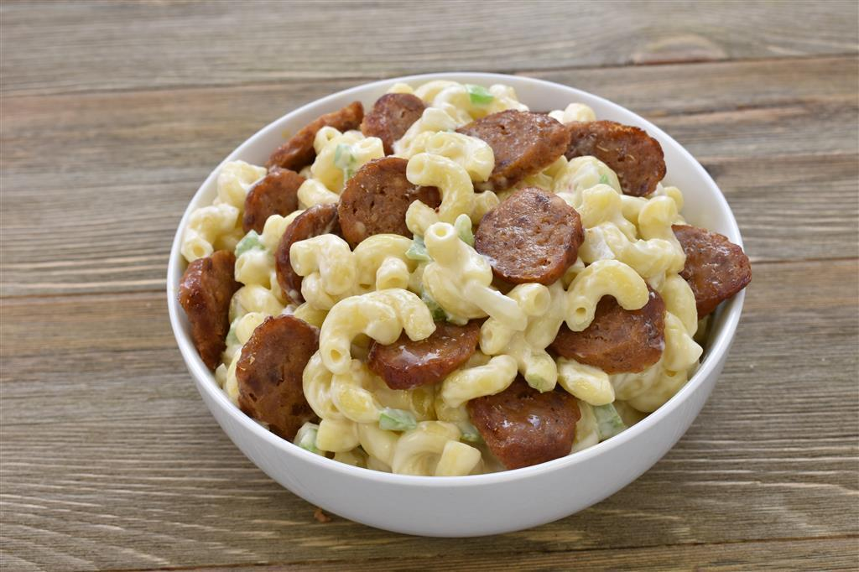
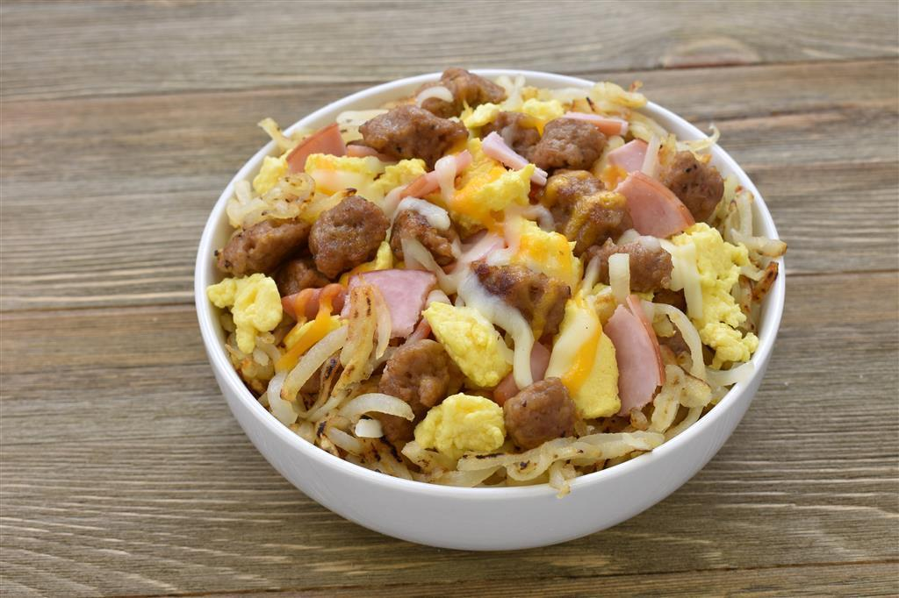
BOWLS +1
Bowls are on 31% of US menus, and have grown +11.9% over the past 4 years.
Sausage has grown +100% in breakfast bowls since 2013.
Source: Datassential MenuTrends 2018, Datassential Bowls Report 2017
Notes:
Farmer’s Morning Bowl: This hearty bowl has Johnsonville Breakfast Sausage crumbles nestled on top of crispy hash browns, fluffy scrambled eggs, Canadian bacon and melted cheddar-jack cheese
10 Customer Business Needs:
Increase in profits
Retain and attract

Slide 23
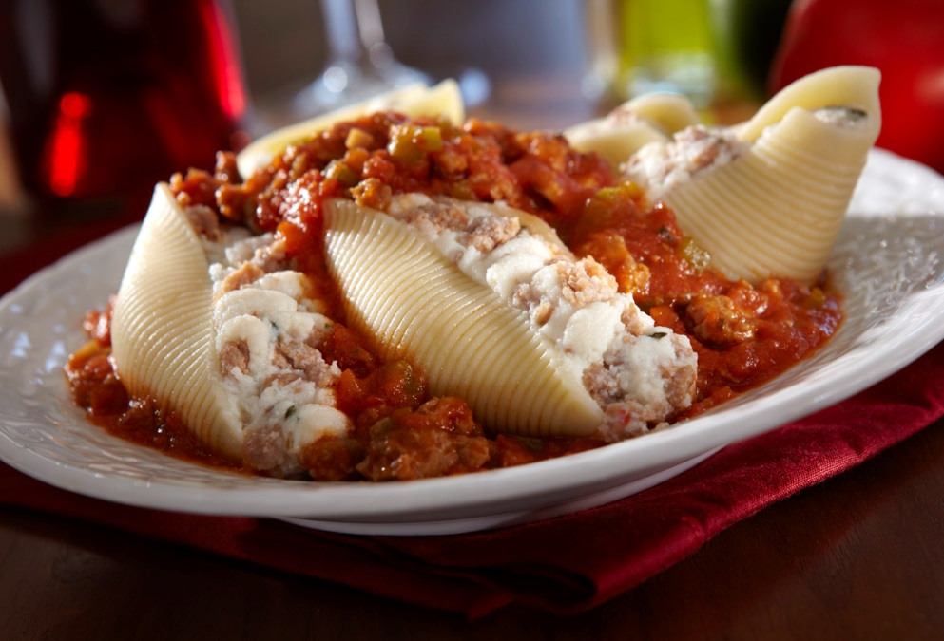
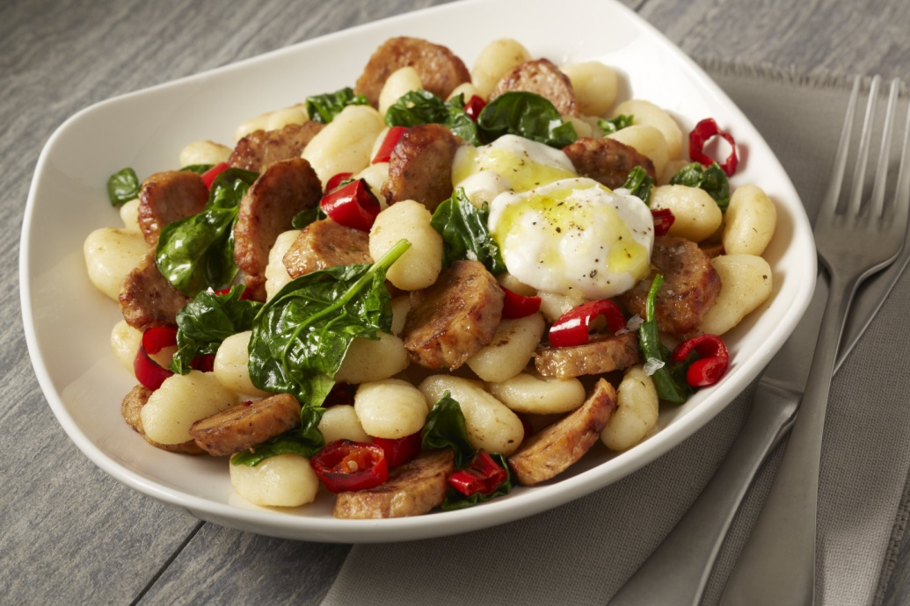
entrees
Sausage is in the
Top 3 of pork proteins for center of plate.
Multi-protein entrees are on 80% of US menus.
Source: Datassential Pork Entrees, February 2018

Slide 24
Burgers
Burgers made with or topped with sausage have grown +300% over the last 11 years.
Sausage as a burger topping has grown +39% since last year.
Source: Datassential MenuTrends 2018
Notes:
Burgers that are made or topped with sausage are most popular at the following:
Casual Dining
Midscale/Family Dining
QSR
10 Customer Business Needs:
Increase in profits
Retain and attract

Slide 25
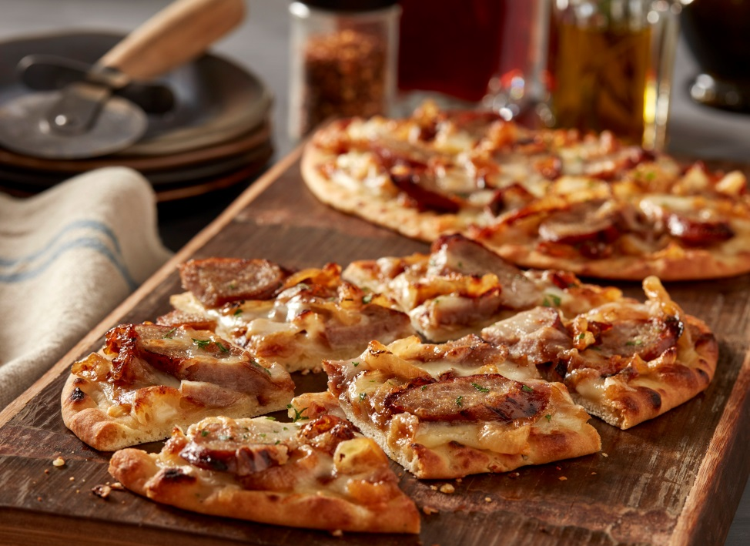
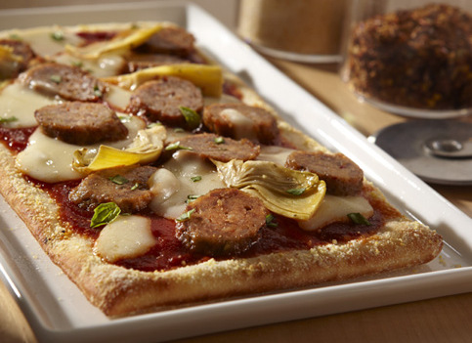
Pizzas and flatbreads
Sausage pizza is on 74% of US pizza menus, and continues to grow.
Fennel sausage on pizza has grown +96% over the past four years.
Source: Datassential MenuTrends 2018, Datasential Protein Pizza Trends 2017

Slide 26
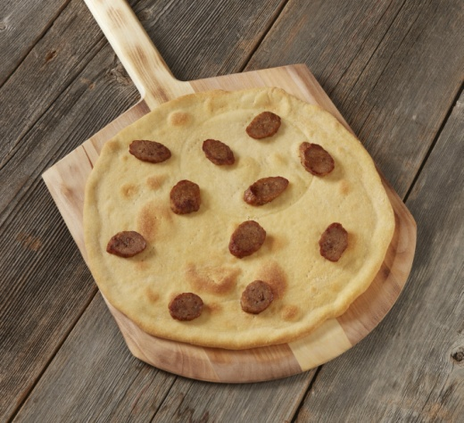
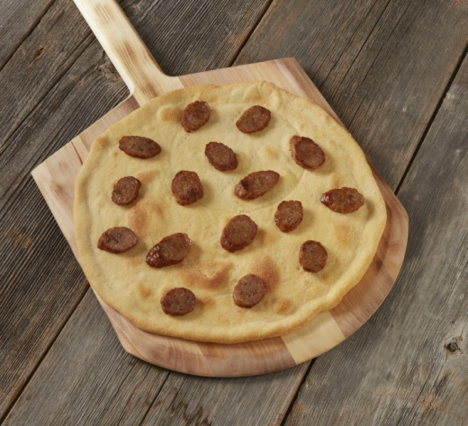
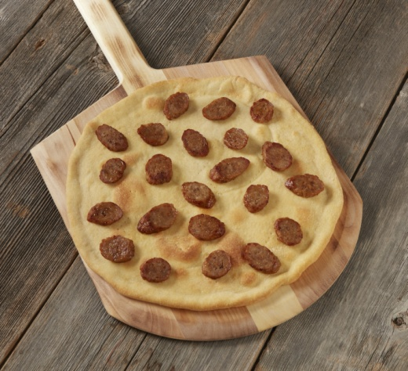
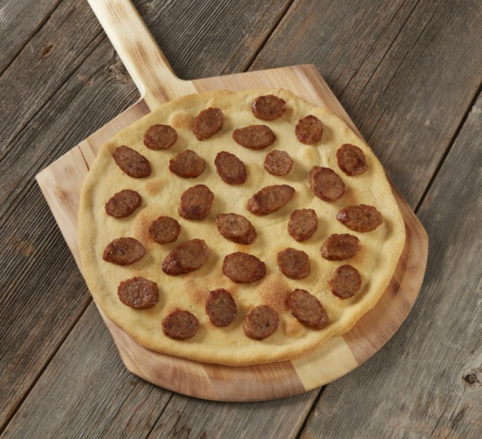
Bias-sliced portion Control – 12 INCH PIZZAS
Dial in your profit margin with Johnsonville Ingredients
2 oz. on 12” crust
3 oz. on 12” crust
4 oz. on 12” crust
5 oz. on 12” crust
Notes:
Customize / Dial in your profit margin

Slide 27
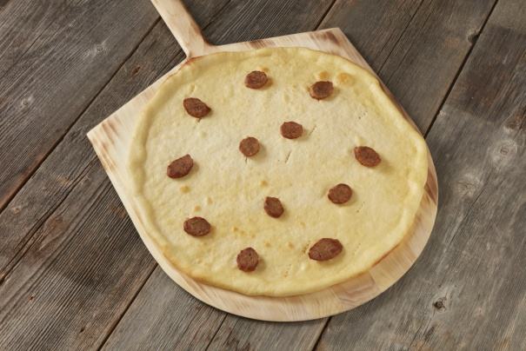
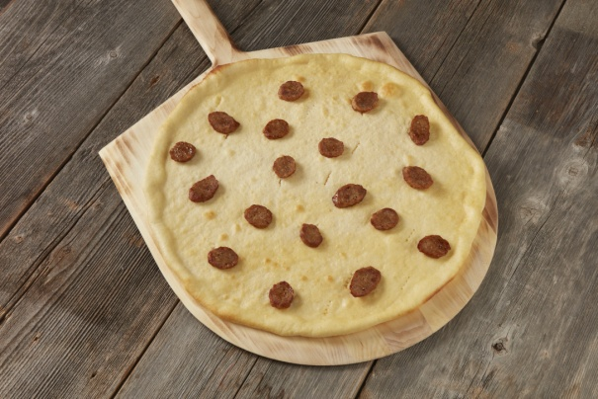
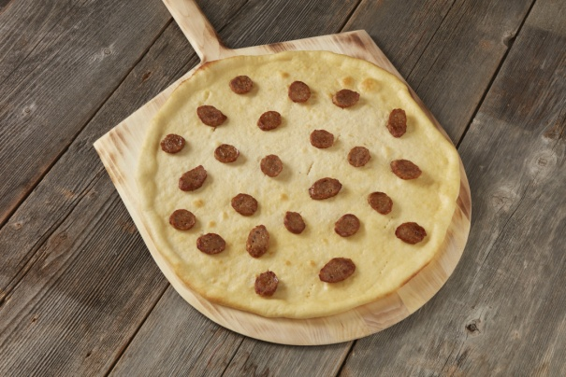
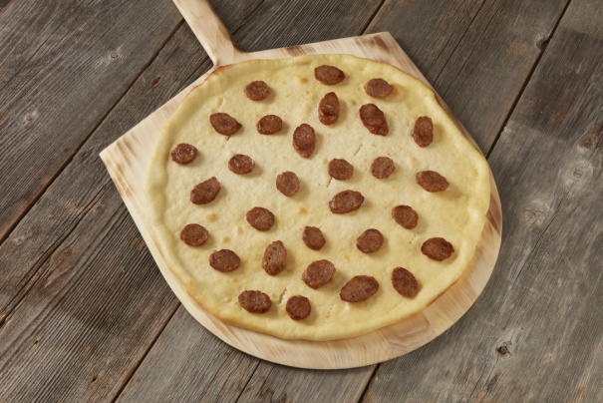
Bias-sliced portion Control – 16 INCH PIZZAS
2 oz. on 16” crust
3 oz. on 16” crust
4 oz. on 16” crust
Dial in your profit margin with Johnsonville Ingredients
5 oz. on 16” crust
6 oz. on 16” crust

Slide 28
Thank you!

Slide 29
Appendix

Slide 30
Amendment info
$.70/slice
$.53/slice
$.812/slice
$22.74/pkg
$.316/slice

Slide 31
Amendment info
Raw Bacon
Hormel Black $.19/slice
Hormel Low Sodium $.20/slice
Hormel Old Smokehouse $.29/slice weight/cooked slice = .24oz
John Morrell Silver $.19/slice weight/cooked slice = .22oz
Prairie Creek $.18/slice weight/cooked slice = .22oz
Cook Yields = 35-28%
Precooked Bacon
Hormel 2/144 @ $79.11/cs = $.27/slice
Prairie Creek 2/150 @ $48.52/cs = $.162/slice 32 slices/raw # .5 oz/slice x 32% yield = .16oz/slice need 6.25 slices = 1oz of cooked bacon!
* 3/1/18 actual operator delivered prices

